Slide 1
Where Did You Go: Personalized Annotation of Mobility Records
Date: 2017/01/17
Author: Fei Wu, Zhenhui Li
Source: CIKM’16
Advisor: Jia-Ling, Koh
Speaker: Pei-Hao, Wu

Slide 2
Outline
•Introduction
•Method
•Experiment
•Conclusion

Slide 3
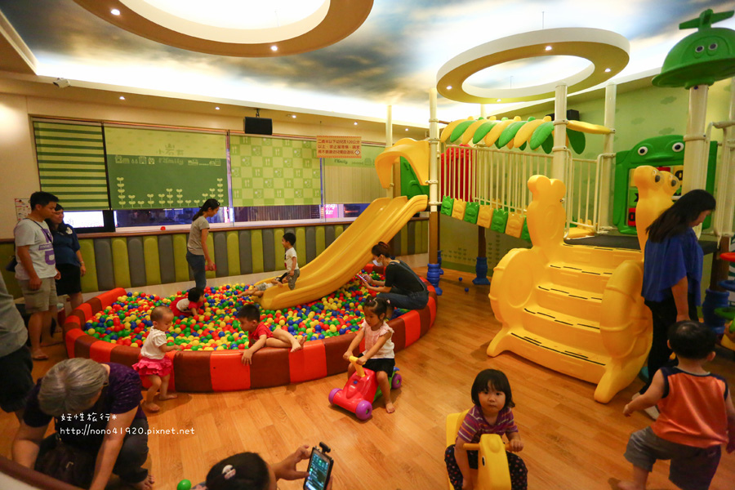
Introduction
Motivation
You would like to go
You might have health problem

Slide 4
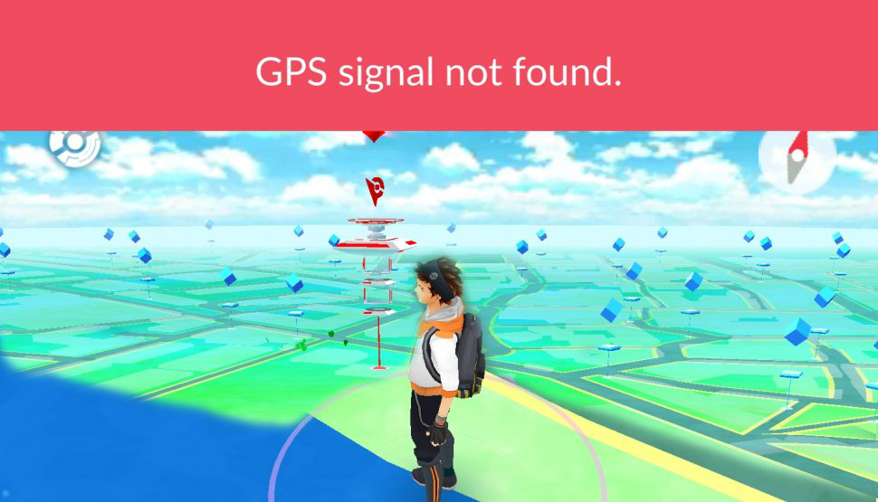
Introduction
Problem
GPS Error
Data collection mechanism

Slide 5
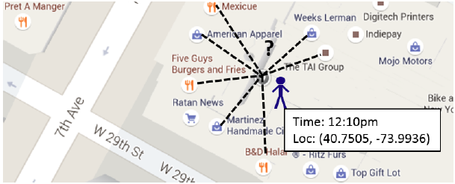
Introduction
Goal
Given a GPS location of the user and knowing where he is visiting.

Slide 6
Introduction
Flow chart
User:
Given mobility records R
r1 = [ (40.75, -73.99), 12:40 ]
r2 = [ (44.75, -75.99), 14:40 ]
.
.
rn = [ (39.75, -73.99), 11:50 ]
Y:
y1 = (r1, v3)
y2 = (r2, v7)
y3 = (r3, v10)
.
.
yn = (rn, vk)
Markov Random Field
Venue:
Name of location V
v1 = [ (40.75, -73.99), (features) ]
.
.
vn = [ (43.75, -69.99), (features) ]

Slide 7
Outline
•Introduction
•Method
•Experiment
•Conclusion

Slide 8
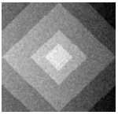
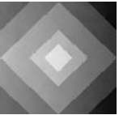
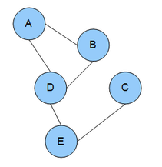
Method
Markov Random Field

Slide 9
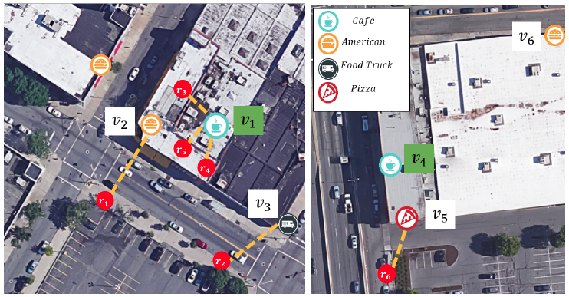
Method
Markov Random Field

Slide 10
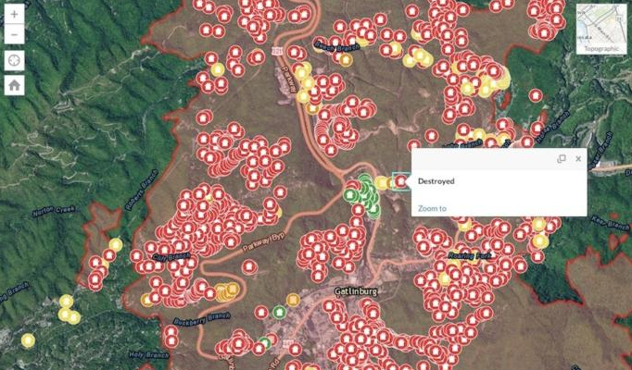
Method
Markov Random Field

Slide 11
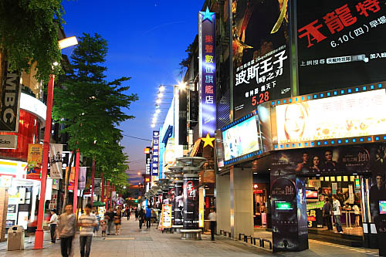
Method
Observation
User’s preferences
Visit similar venues at close locations
Visit similar venues at similar time of the day

Slide 12
Method
Connect the mobility records
[ (40.75, -73.99), 12:00 ]
[ (121.75, -13.99), 23:40 ]
r1
r4
50min
Connect by time
50min
Connect by time
r2
r3
[ (30.5, -73.99), 11:10 ]
[ (30.5, -73.5), 12:50 ]
50m
Connect by distance

Slide 13
Method
How to label the mobility with venue?
$$v_{?}$$
$$v_{?}$$
r1
r4
Y:
y1 = (r1, v3)
y2 = (r2, v7)
y3 = (r3, v10)
.
.
yn = (rn, vk)
r2
r3
$$v_{?}$$
$$v_{?}$$

Slide 14
Method
Markov Random Field
Y:
y1 = (r1, v3)
y2 = (r2, v7)
y3 = (r3, v10)
.
.
yn = (rn, vk)
( distance of v to r )
( probability of labeling v to r )

Slide 15
Method
Markov Random Field
[ (40.75, -73.99), 12:00 ]
[ (30.5, -73.99), 11:10 ]
[ (30.5, -73.5), 12:50 ]
r1
r2
r3
Case 1
v1 v2 v3
--------------------------------------------------------------------------
v1 v3 v2
--------------------------------------------------------------------------
v2 v1 v3
--------------------------------------------------------------------------
v2 v3 v2
--------------------------------------------------------------------------
v1 v1 v1
--------------------------------------------------------------------------
v1 v3 v3
Case 1:
= [ exp(-D(r1, v2))*exp(-D(r2, v2))*exp(-D(r3, v3)) ]
= [ exp(-2)*exp(-3)*exp(-4) ]
= 0.13 * 0.05 * 0.02 = 0.000325
Case 2
Case 3
Case 4
= (v1, v2) * (v1, v3) * (v2, v3)
= 1 * e(-0.01) * e(-0.1) = 0.99 * 0.9 = 0.891
Case 5
Case 6
*
= 0.000289575

Slide 16
Method
*
= 0.000289575
Markov Random Field
Case 1:
= [ -log(exp(-2)) – log(exp(-3)) – log(exp(-4)) ]
= 0.886 + 1.301 + 1.698 = 3.885
= -log(1) – log(e(-0.01)) – log(e(-0.1))
= 0 + 0.0043 + 0.045 = 0.0493
+
= 3.9343

Slide 17
Outline
•Introduction
•Method
•Experiment
•Conclusion

Slide 18
Experiment
Datasets
Data from three major cities
New York City (NYC)
Chicago (CHI)
Los Angeles (LA)

Slide 19
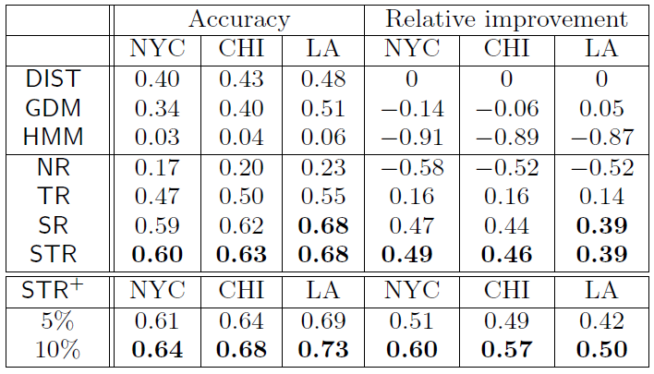
Experiment
Methods compared

Slide 20
Experiment
Methods compared

Slide 21
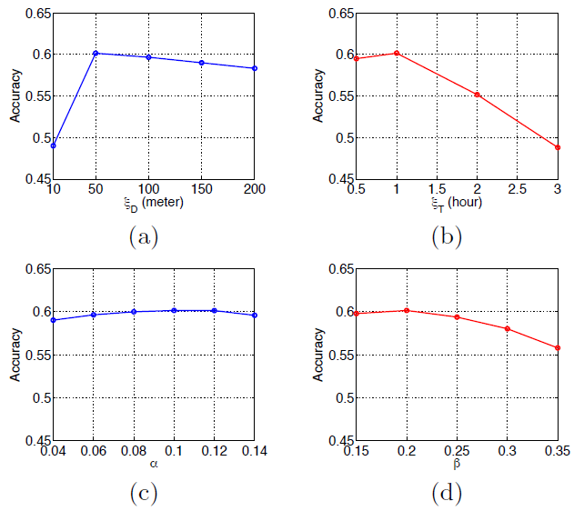
Experiment
Parameter Sensitivity

Slide 22
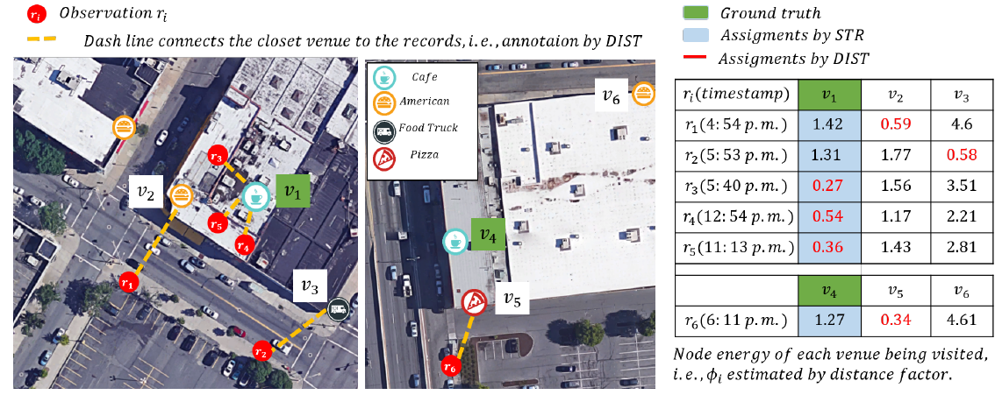
Experiment
Case Study

Slide 23
Outline
•Introduction
•Method
•Experiment
•Conclusion

Slide 24
Conclusion
Propose a novel Markov random field model to capture personal preference using all the location records of each user
Bridge the gap between raw mobility records and surrounding contexts
Solve the problem of annotating venue to mobility records and understand of the mobility data

